Slide 1
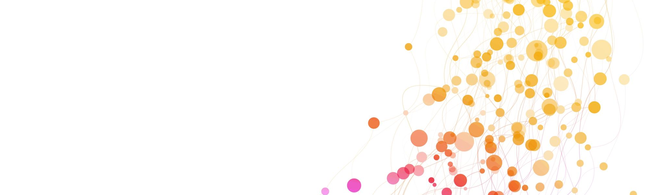
Smart System Anomaly Detection
Presented by Ahmed Gharbi

Slide 2
1) Problem statement & goals
Context
We analyze telemetry data (CPU, network, device info, location).
Includes normal traffic + simulated attacks (DoS, Injection, Spoofing).
Goals
Detect and classify anomalies
Test in realistic scenarios
Provide clear explanations

Slide 3
2) Data & preprocessing
Source
Dataset: `smart_system_anomaly_dataset.csv`
Dataset includes:
Numeric: CPU, memory, latency, bandwidth
Categorical: device type, protocol, region
Steps
Handle missing values
Normalize data
One-hot encode categories

Slide 4
3) Models Used
We use a scikit-learn pipeline.
Models evaluated
Logistic Regression (baseline)
Random Forest (complex patterns)
HistGradientBoosting (fast & powerful)
Outputs
Predicted label + confidence

Slide 5
4) Evaluation strategy
We simulate real-world conditions:
- Random split (baseline)
- Time-based split (future prediction)
- Group split (new devices)
This makes evaluation more realistic.

Slide 6
5) Explainability:
Idea: for an anomalous row, find the closest normal row in the transformed feature space.
Procedure
- Transform normal samples using the fitted preprocessor
- Fit `NearestNeighbors` on those vectors
- For each anomaly: nearest normal + deltas on key features
Benefit
- Simple explanation: “what changed the most vs a similar normal behavior”

Slide 7
6) Application (Streamlit)
User can :
1. Upload CSV
2. Get predictions
3. View anomaly explanations
4. Download results
If `label` is provided the it shows the performance metrics

Slide 8
7) Architecture & reproducibility
Offline
Training: `train.py`
Artifacts: `artifacts/model.joblib`, `normal_vectors.npy`, `normal_explain.csv`, `train_summary.json`
Online
Inference: load artifacts → predict → explain
App: `app.py` (Streamlit)
Deployment
GitHub + Streamlit Community Cloud
`runtime.txt` pins Python 3.11 for scientific-stack compatibility

Slide 9
8) Results, limitations & next steps
Results
Good performance
Examples of explained alerts (DoS / Injection / Spoofing)
Limitations
Supervised model depends on label availability
Generalization to new devices/protocols/regions
Next steps
- Thresholding (reject low-confidence predictions)
- Probability calibration
- Error analysis (confusions between attack classes)

